Slide 1
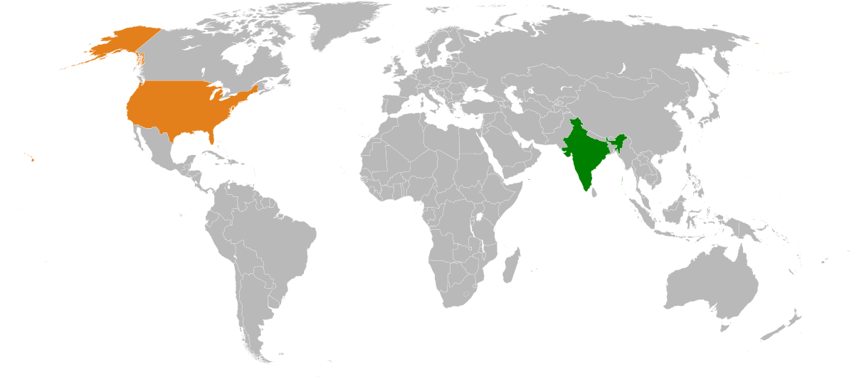
Analysis of investment pattern in small business for USA and India
ANA625 – Course Project
By Aditi Bhujbal
Date: March 25th 2022

Slide 2

Objective
To investigate whether there is any association between ‘getting an investment for a small business’ and different domains that the business belongs to, while considering the fact that the sample product was presented to investors and the country.

Slide 3

How it started?
Shark Tank : Business reality series
A business reality series, where entrepreneurs make their business presentations to a panel of investors, who decide whether to invest in their company or not

Slide 4

Dataset
Dataset links:
https://www.kaggle.com/competitions/ban-502-shark-summer-2021/data
https://www.kaggle.com/datasets/sriomsubham/shark-tank-data-121pitches
These datasets contain the information regarding ideas that were presented on Shark Tank (USA and India).
Number of records is 672.
Number of records for USA = 551 and for India is 121.
24 records have missing value for Sector variable (3.57%).

Slide 5
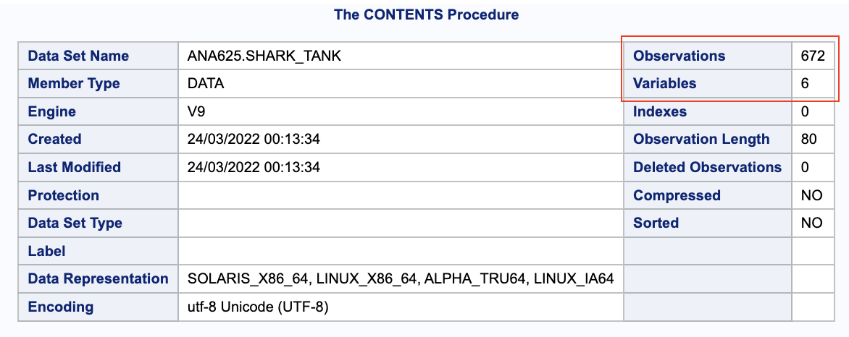
Proc content output generated by SAS for dataset

Slide 6

Feature Engineering
Created new categorical variables:
Deal_yes & deal_no → DEAL(Yes/no)
Dummy variables for presenter : male,female and both → Sex(male/female/mix)
Dummy variables for sector → sector (Technology, Health, Lifestyle, etc.)
Merged the two datasets
Updated missing values.

Slide 7
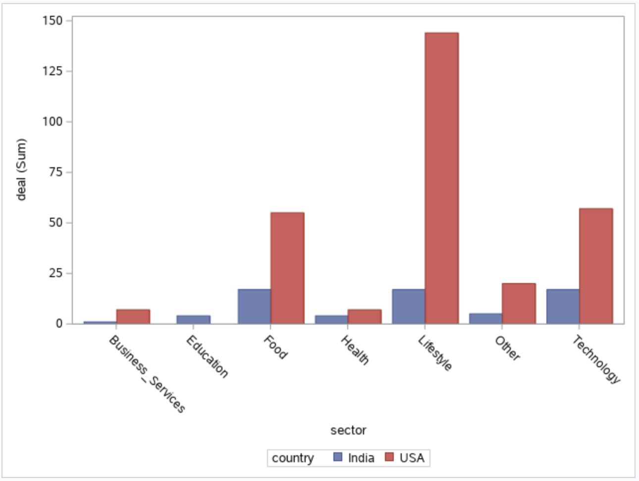
Graphical representation

Slide 8
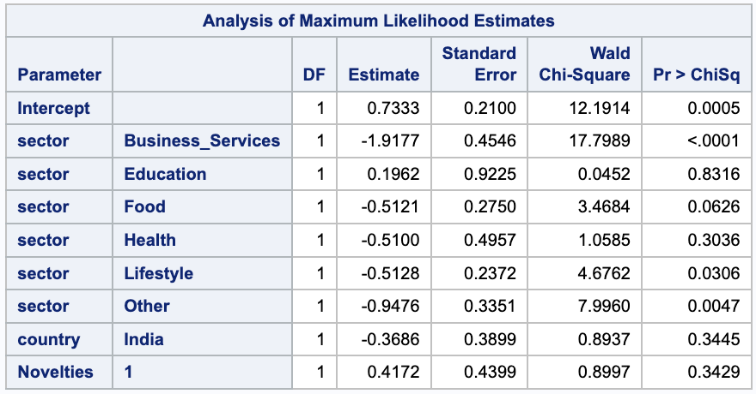
Logistic Regression Model
Null hypothesis:
H₀ = There is no association between DEAL and SECTOR
i.e. ß₁ = ß₂ = ß₃ = 0.
Main Effect model:
DEAL = ß₀ + ß₁ (SECTOR) + ß₂ (COUNTRY) + ß₃ (NOVELTIES)
_{Outcome variable : DEAL}
_{Exposure Variable : SECTOR}
Controlled for : COUNTRY & NOVELTIES

Slide 9
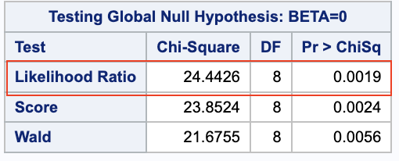
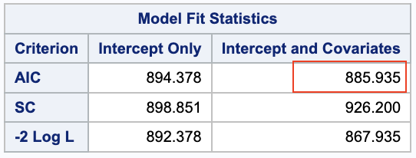
Global Chi-Squared and AIC test
Global Chi-Square = (X_{G})² = -2LogL(Intercept) + -2LogL(Intercept + Covariate) = 892.378 – 867.935 = 24.44
Since, P-value of likelihood ratio is 0.0019 < 0.05, we can reject null hypothesis that ß₁ = ß₂ = ß₃ ≠ 0 .
Akaike’s Information Criterion (AIC):
Since AIC_{(Intercept only)} > AIC_{(Intercept + Covariates)}, we can null hypothesis.
Hence we can say that, main effects model i.e. DEAL = f(SECTOR, COUNTRY, NOVELTIES) is better fitting model than the intercept only model.

Slide 10
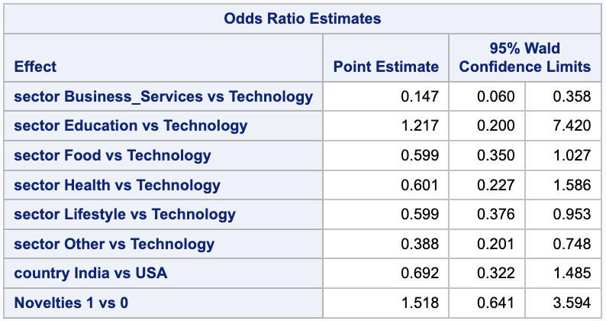
Odds Ratio of Deal w.r.t. Sector, Country and Novelties.
Although Business_Services, lifestyle and other domains have lower odds of getting deal than technology, but these ORs are statistically significant as their 95% CI do not include 1.

Slide 11
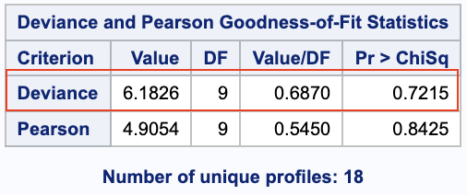
Deviance Test
H₀ : Coefficient on interaction term is 0
or
Current model fits the data better than saturated model.
Deviance statistic value = 6.1826, indicates that there’s a little variation unexplained by current model.
P-value = 0.7215 which is > 0.05, i.e. this deviance is not statistically significant.
Therefore, current model fits the data better than saturated model.

Slide 12
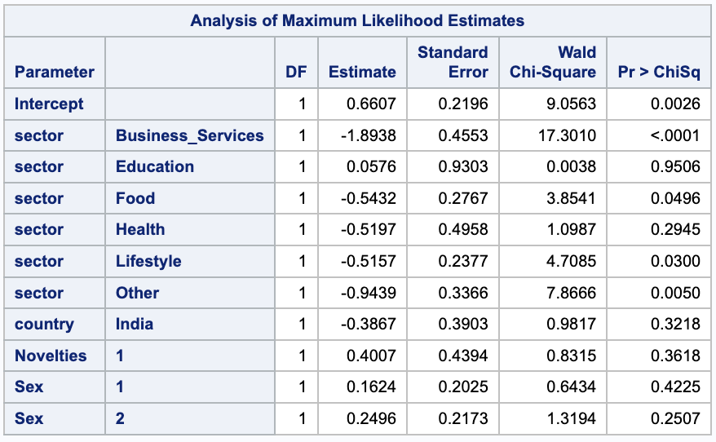
Full Model
DEAL = ß0+ ß1(Sector) + ß2(Country) + ß3(Novelties) + ß4(Sex)
or
DEAL = ß₀ + ß₁(sector=Business_Services) + ß₂(sector=Education) + ß₃(sector=Food) + ß₄(sector=Health) + ß₅(sector=Lifestyle) + ß₆(sector=Other) + ß₇(Country=India) + ß₈(Novelties=1) + ß₉(sex=1) + ß₁₀(sex=2)

Slide 13
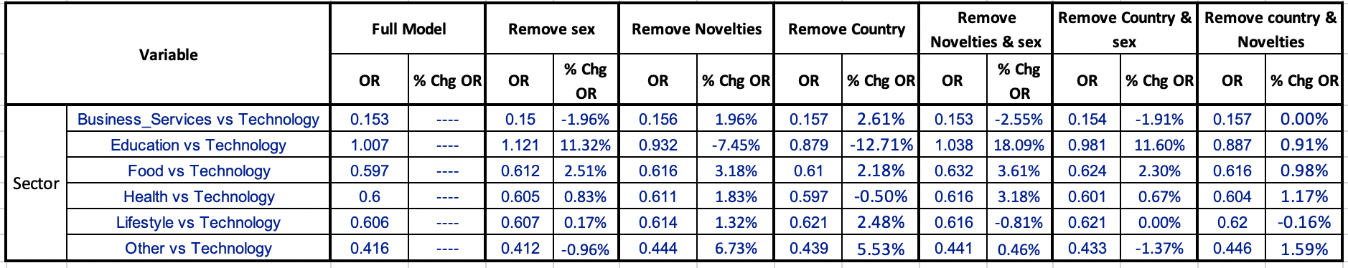
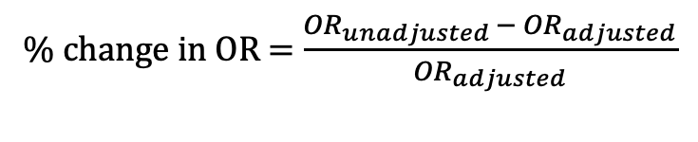
Confounding
% change in OR = $\frac{{OR}_{unadjusted }− {OR}_{adjusted}}{{OR}_{adjusted}}$
Change in OR is less than 10% for all the models generated by removing variables Sex, Novelties, Country one at a time. Thus, relationship between DEAL and SECTOR can not be confounded by relationship between sector and Country or sector and Novelties or sector and Sex.
Coefficients of Country, Novelties and sex : p-value > 0.05, i.e. they are not statistically significant, hence they cannot be retained in the model.

Slide 14

Conclusion
DEAL = f(SECTOR, COUNTRY, NOVELTIES)
Based on the results of Global-chi squared and Deviance tests, we can conclude that there is an association between “DEAL” and “SECTOR”.
From the results of full model and %change in OR, we can say that Country and novelties are neither confounding variables nor they’re controlled for in this model.

Slide 15

Future Work
Analysis of continuous variables e.g. invested amount, equity.
Include data from other countries.

Slide 16


